Slide 1
Lecture – 14

Slide 2
The Processor:
Datapath and Control

Slide 3
Instruction Execution
For every instruction the first two steps are:
Send the program counter (PC) to the memory that contains the code and fetch the instruction from that memory.
Read one or two registers, using the fields of the instruction to select the registers to read.

Slide 4
The Processor: Datapath & Control
Our implementation of the MIPS is simplified
  memory-reference instructions: lw, sw
  arithmetic-logical instructions: add, sub, and, or, slt
  control flow / branch instructions: beq, j
Generic implementation
  use the program counter (PC) to supply the instruction address and fetch the instruction from memory (and update the PC)
  decode the instruction (and read registers)
  execute the instruction
All instructions (except j) use the ALU after reading the registers
How? memory-reference? arithmetic? control flow?
Fetch
PC = PC+4
Exec
Decode
Notes:
memory reference use ALU to compute addresses
arithmetic use the ALU to do the require arithmetic
control use the ALU to compute branch conditions.

Slide 5
Instruction Execution
All instruction classes, except jump, use the ALU after reading the registers.
The memory-reference instructions use the ALU for an address calculation.
The arithmetic-logical instructions use the ALU for operation execution.
Branch instructions use the ALU for comparison.

Slide 6
Instruction Execution
After using the ALU, the actions required to complete various instruction classes differ.
A memory reference instruction will need to access the memory either to write data for a store or read data for a load.
Arithmetic-logical instruction must write the data from the ALU back into a register.
A branch instruction may change the next instruction address based on the comparison, otherwise the PC should be incremented by 4 to get the address of the next instruction.

Slide 7
MIPS Instruction Format
All instructions are 32 bits with a 6-bit primary opcode.
I-type instruction (Transfer, branch, imm. format)
6 5 5 16
Opcode | rs | rt | Immediate
Example: ADDI Rs, Rt, IMM
R-type instruction (Arithmetic instruction format)
6
5
5
5
5
6
Opcode | rs | rt | rd | shamt | funct
Example: ADD Rd, Rs, Rt
SLL Rd, Rt, Shamt

Slide 8
MIPS Instruction Format
J-type instruction (Jump instruction format)
6 26
Opcode Offset added to PC
Example: J ADR

Slide 9
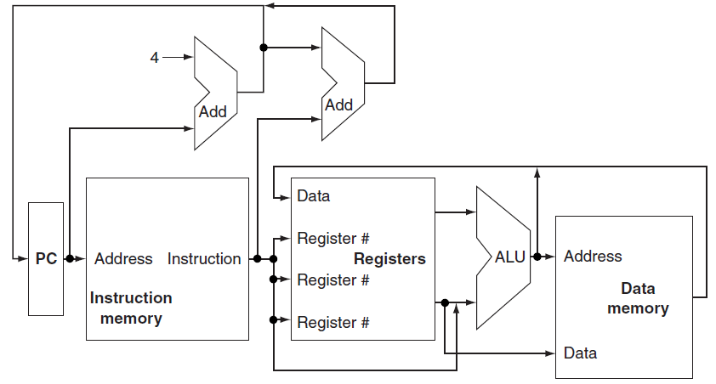
An abstract view of the implementation of the MIPS subset

Slide 10
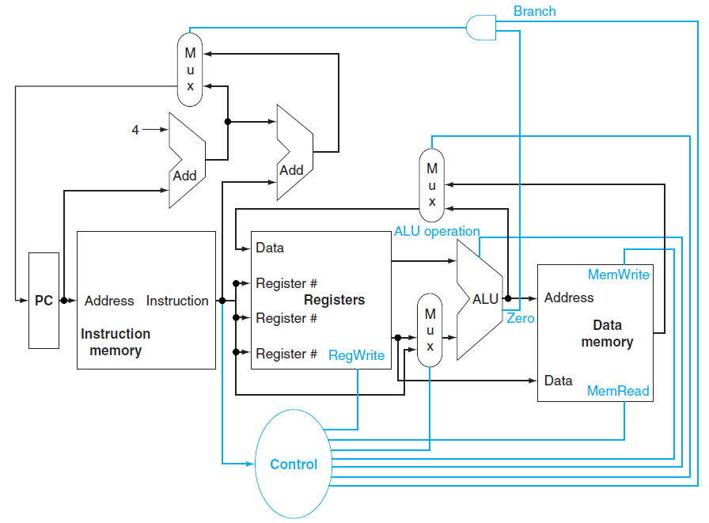
The basic implementation of the MIPS subset

Slide 11
The Single Cycle Datapath
Takes a single long clock cycle for every instruction.
Every instruction begins execution on one clock edge and completes execution on the next clock edge.
Reasons for separate Memory and Data Unit:
The format of data and instruction is different in MIPS.
Less Expensive.
The processor operates in one clock cycle and cannot use a single-ported memory for two different accesses within that cycle.

Slide 12
Logic Design Conventions
Read Yourself

Slide 13
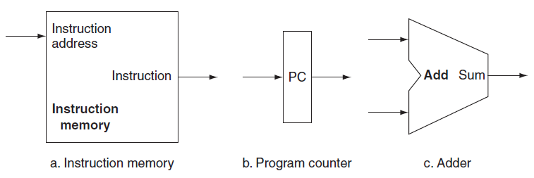
Building a Datapath
Two state elements (instruction memory and program counter) are needed to store and access instructions.
An adder is needed to compute the next instruction address.

Slide 14
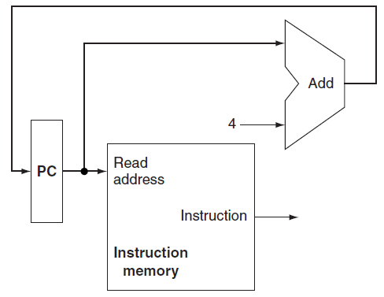
Building a Datapath
It fetches instructions and increments the PC to obtain the address of the next sequential instruction.

Slide 15
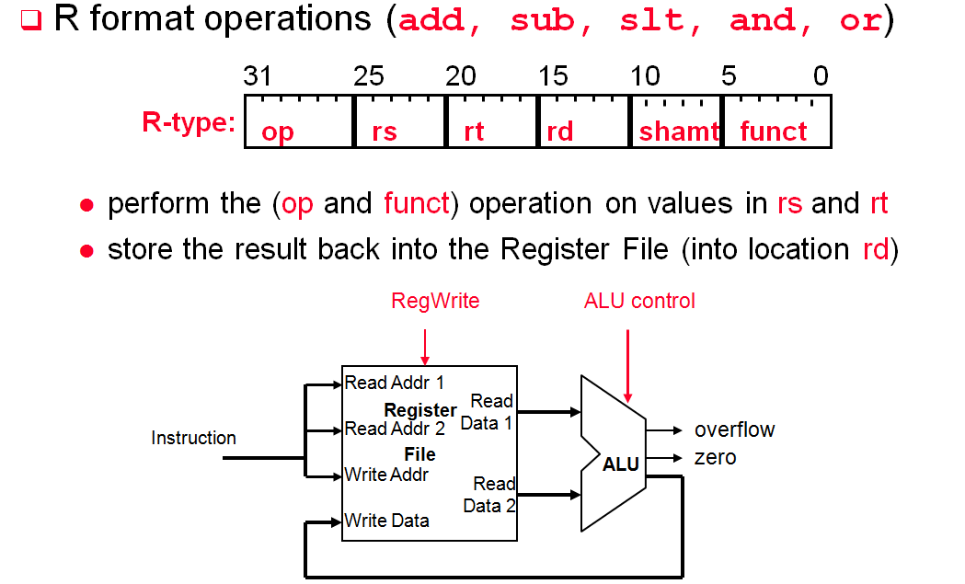
  The Register File is not written every cycle (e.g. sw), so we need an explicit write control signal for the Register File

Slide 16
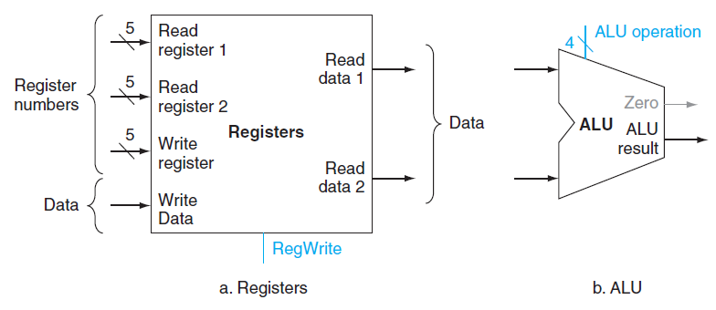
Data elements needed to implement
R-type instructions

Slide 17
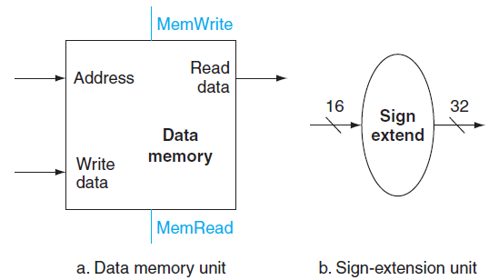
Data elements needed to implement
Load and Store

Slide 18
Executing Branch Operations
Branch operations involves
  compare the operands read from the Register File during decode for equality (zero ALU output)
  compute the branch target address by adding the updated PC to the 16-bit signed-extended offset field in the instr
Add
Branch
target
address
4
Add
Shift
left 2
ALU control
PC
Read Addr 1
zero
(to branch control logic)
Register
File
Read
Data 1
Instruction
Read Addr 2
Write Addr
ALU
Read
Data 2
Write Data
Sign
Extend
16
32

Slide 19
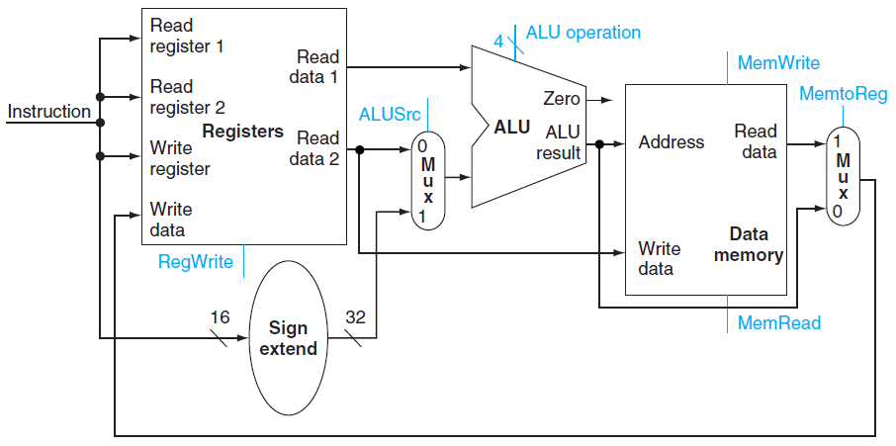
Datapath for the Memory Instruction and R-type instruction

Slide 20
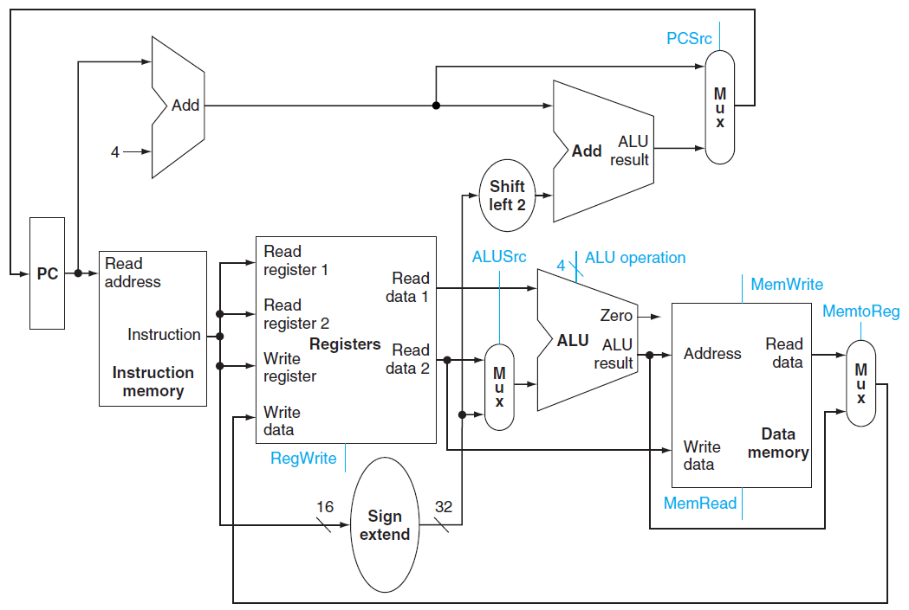

A Simple Datapath for the MIPS Architecture

